Slide 1


















HOME AUTOMATION USING GESTURES
REG.NO : 20BAI1049
: PHAROS SOPHY SAMUEL T J
: BHAVADHARINI R M
NAME GUIDE

Slide 2




Problem Statement
Controlling appliances through buttons and tangible devices has been the
traditional way.
This project aims at enhancing the human-computer interaction by using gestures controls the fan speed and brightness of a bulb & a led.
Given times where people might feel too lazy or tired to give voice commands, simple gestures or actions could make the communication process easier.
Moreover, such gesture based home automation greatly aids the speech impaired people to interact with smart devices at home, possibly.
Instead of taking a single picture, we record frames of the movement through cameras that detect the gestures delivered.

Slide 3


Research Objective
Goal: Create a gesture-based home automation system which controls the
fan speed and brightness of a bulb & a led.
Technology: Uses computer vision & machine learning for hand gesture recognition.
Purpose: Control household appliances through recognized gestures. Aim: Innovate for user-friendly smart homes.
Benefits: Enhances convenience, accessibility, and efficiency in daily living.

Slide 4
Proposed System - Proposed System Introduction
"Home-based Automation Using Hand Gestures," leverages the Arduino Uno board
and the CNN algorithm for hand gesture recognition.
When showing swing gesture, the system turns on the fan at full speed.
Using thumbs up reduces the fan speed.
Fist gesture activates the bulb
Palm gesture decrease the brightness of both lights.
Peace gesture turns off the entire system.
The hardware components include the Arduino Uno, a small fan, a bulb and a power source.

Slide 5

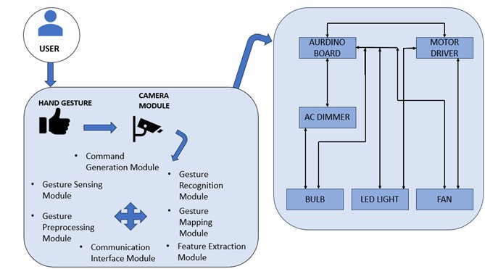
Proposed System Diagram

Slide 6
c) List of modules
Gesture Sensing Module
Gesture Preprocessing Module Feature Extraction Module Gesture Recognition Module Aurdino UNO
Power Source

Slide 7
d) Explanation of all the modules
Gesture Sensing Module:
Hardware: Camera is used as a device for capturing hand movements. Functionality: Captures real-time hand gestures within a defined space.
Gesture Preprocessing Module:
Functionality: Cleans and preprocesses raw gesture data, removing noise or irrelevant information.
Tasks: Filtering, noise reduction, background subtraction.

Slide 8
3. Feature Extraction Module:
Functionality: Extracts relevant recognition.
features from preprocessed gesture data for
Techniques: Histogram of Oriented Gradients (HOG) feature extraction methods.
4. Gesture Recognition Module:
Algorithms: Convolutional Neural Networks (CNNs) recognition models. Tasks: Interprets extracted features, recognizes specific hand gestures.

Slide 9
Gesture Mapping Module:
Functionality: Maps recognized gestures to predefined commands or actions. Tasks: Associating gestures with specific functions (e.g., turning lights on/off)
Communication Interface Module:
Protocols: Wi-Fi, Bluetooth, Zigbee, or other communication protocols.
Tasks: Facilitates data exchange between processing units and home automation devices.

Slide 10
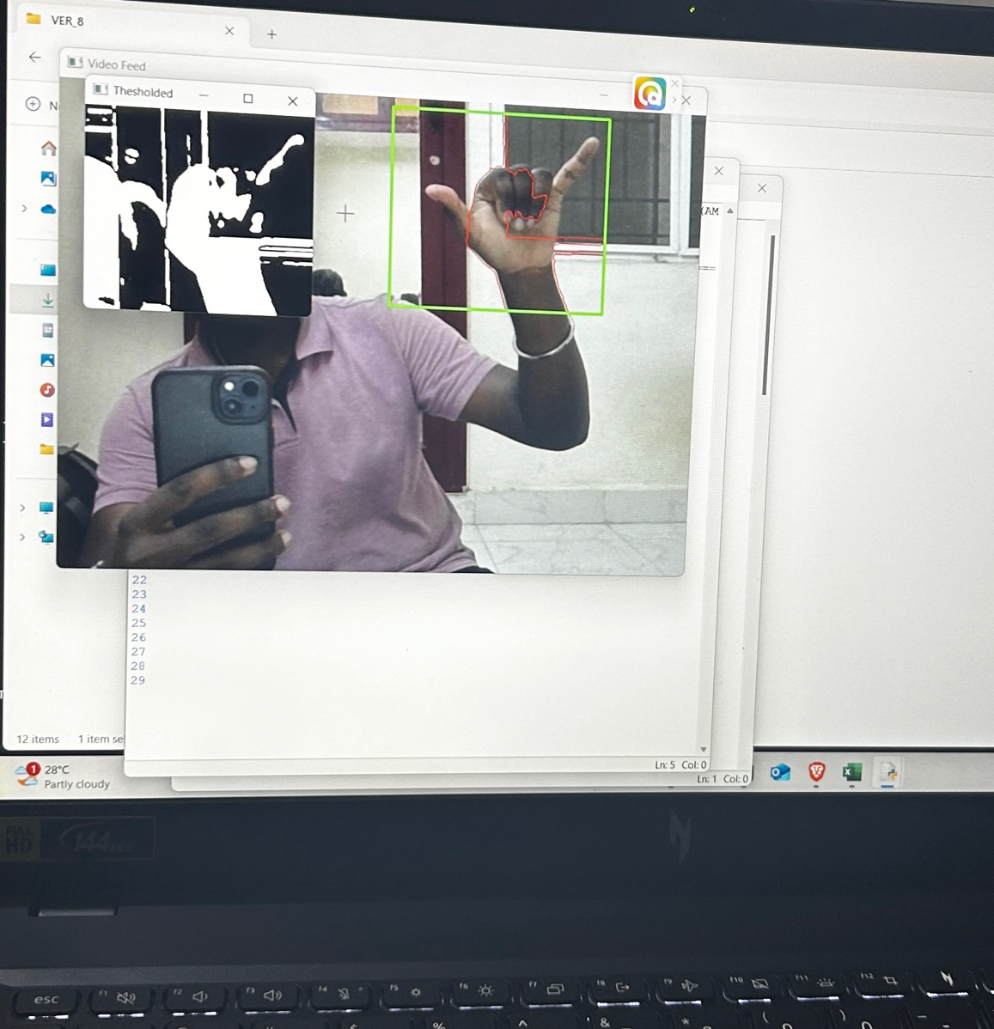
Results and Discussions

Slide 11
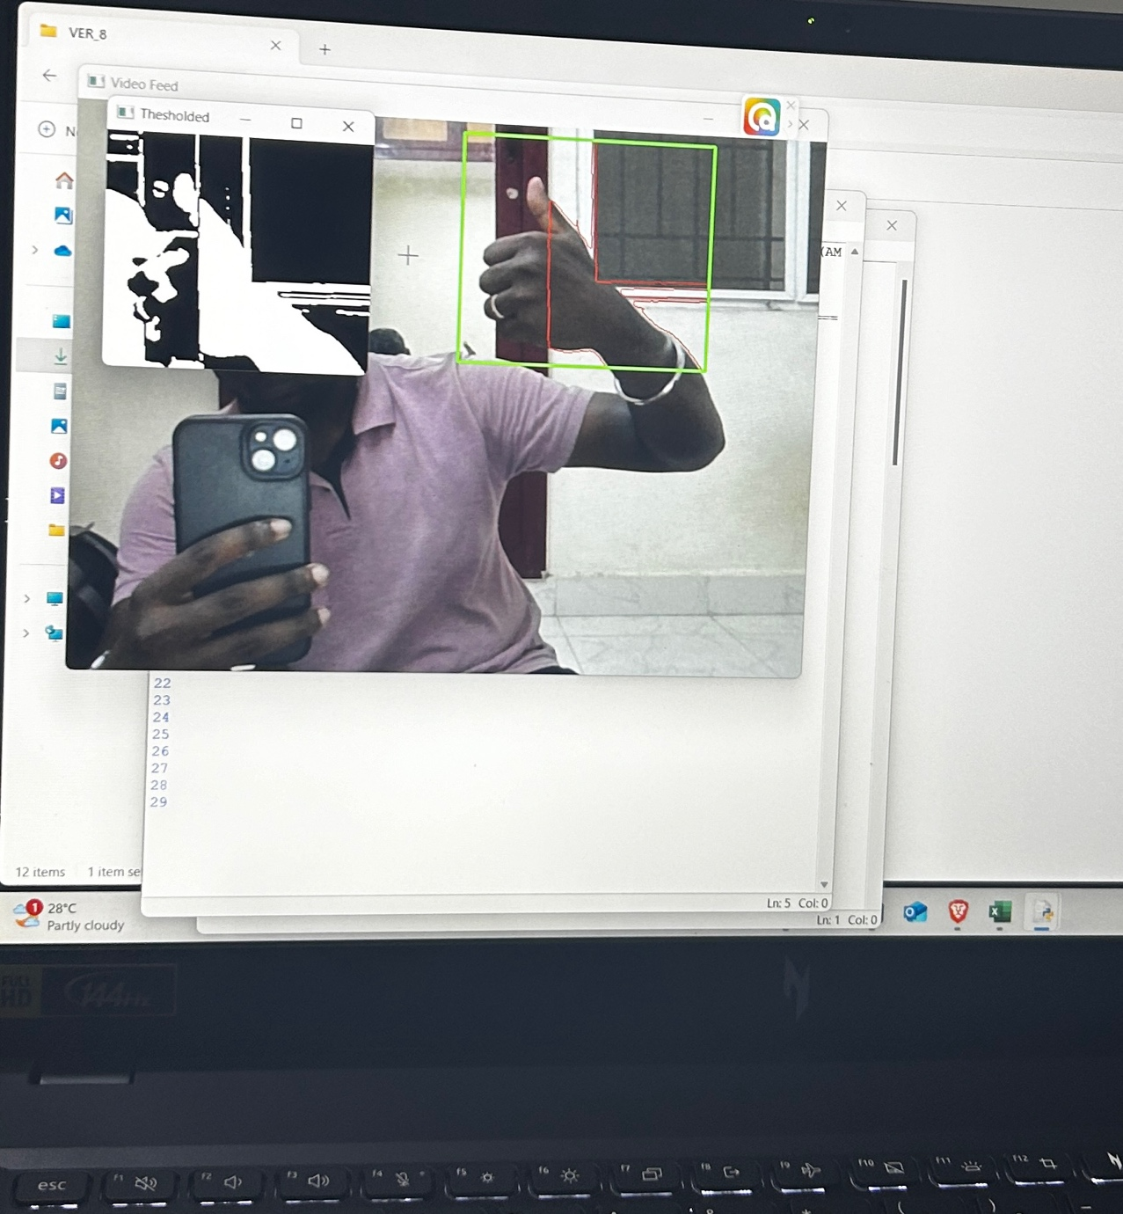

Slide 12
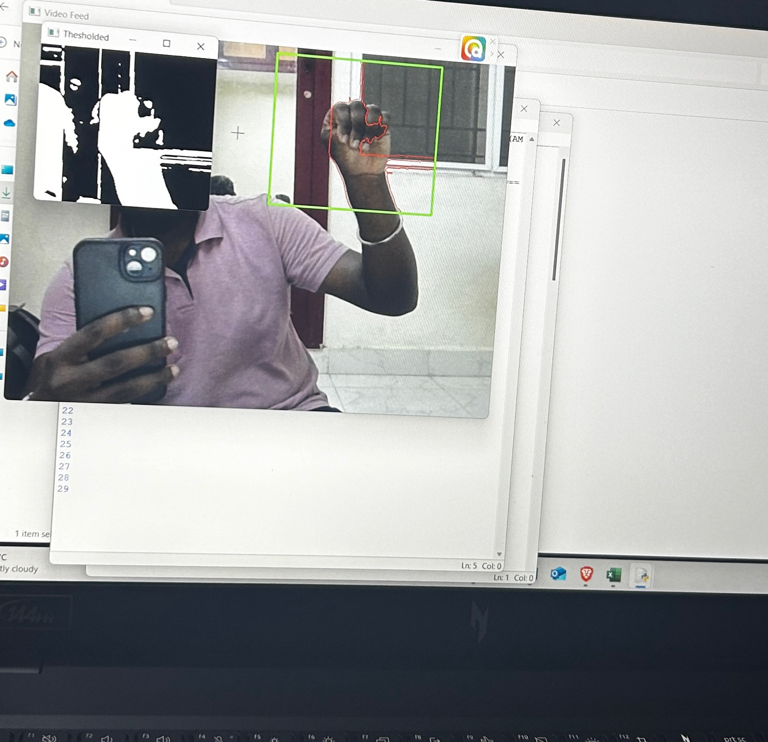

Slide 13
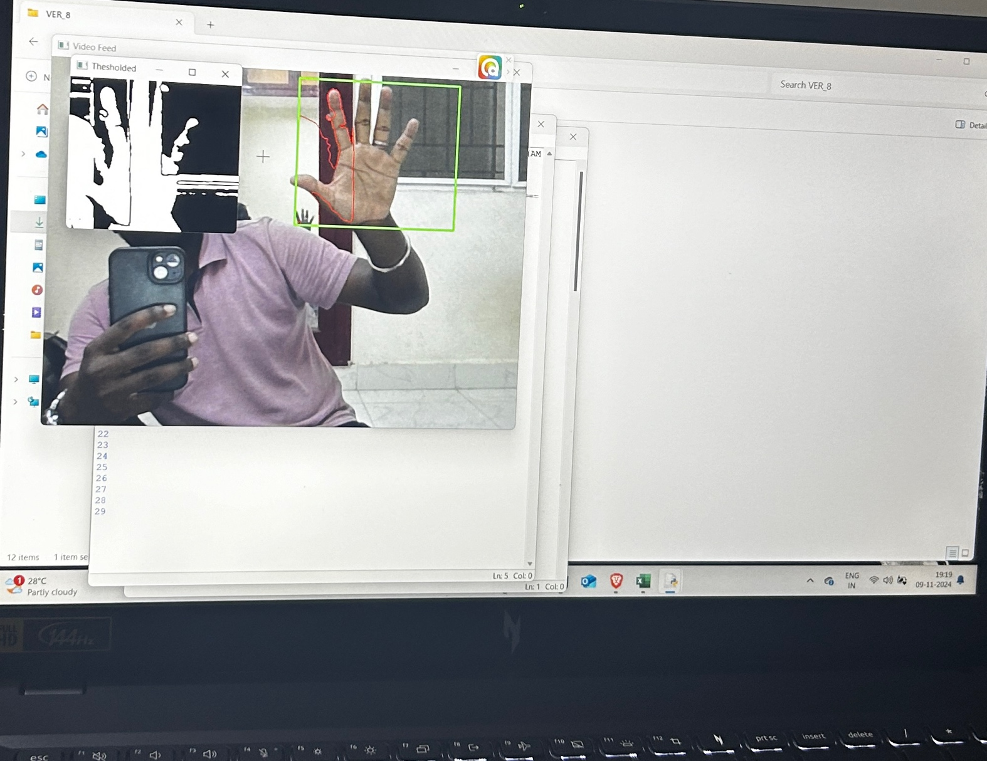

Slide 14
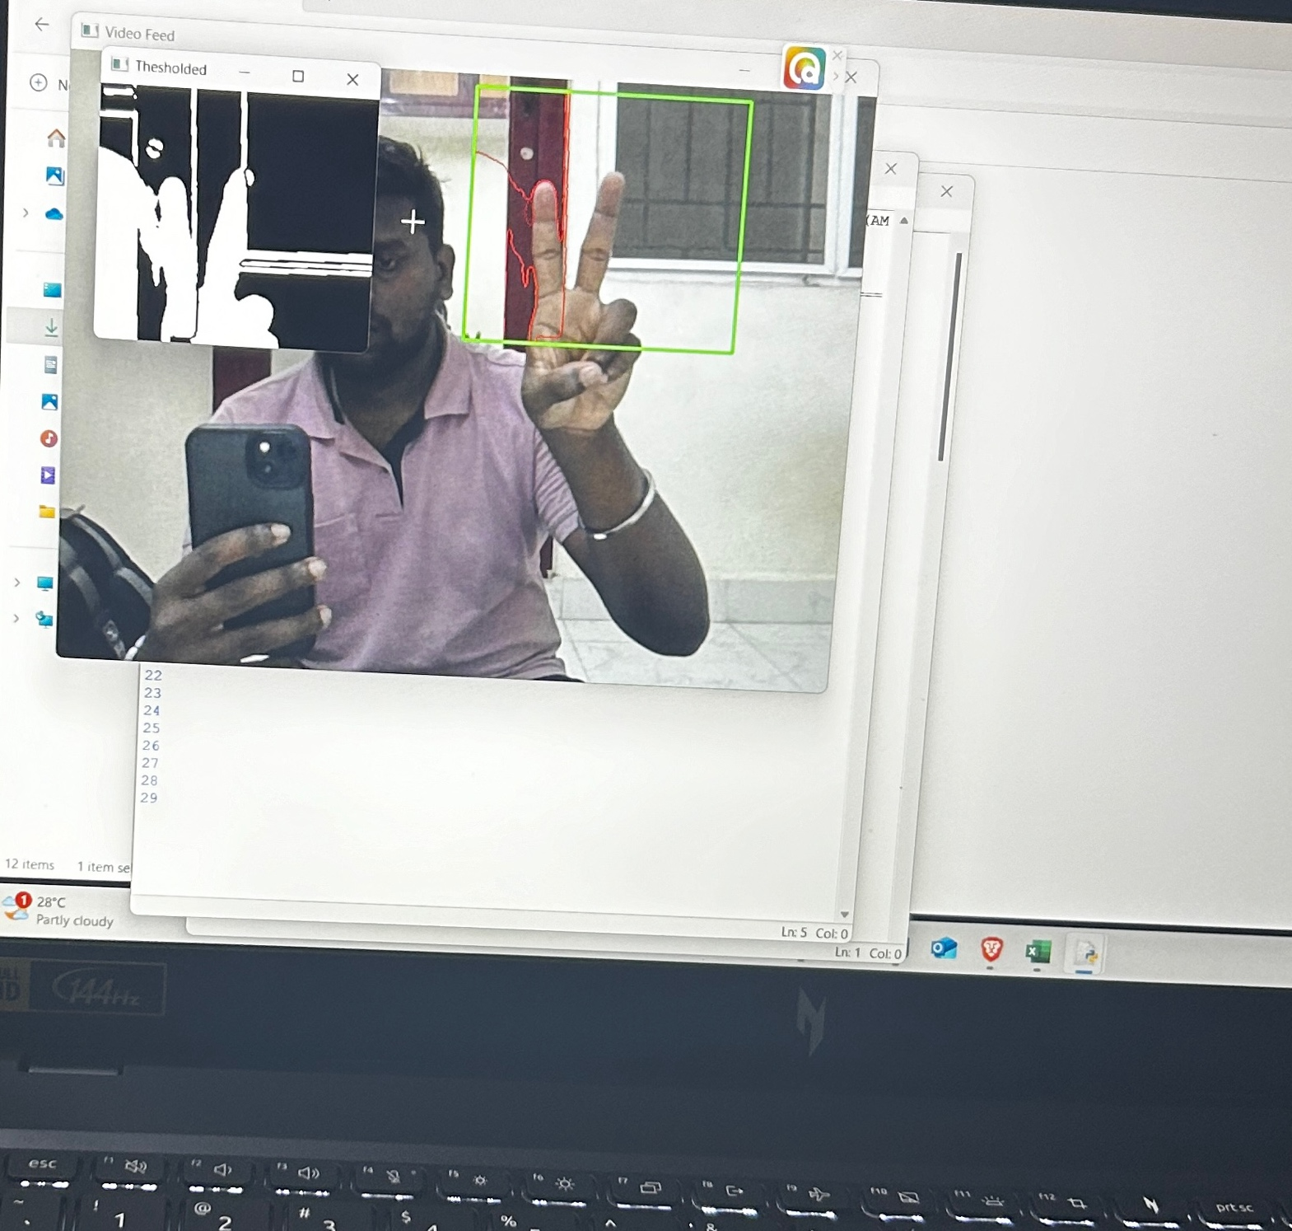
Hardware implementation will be Shown

Slide 15
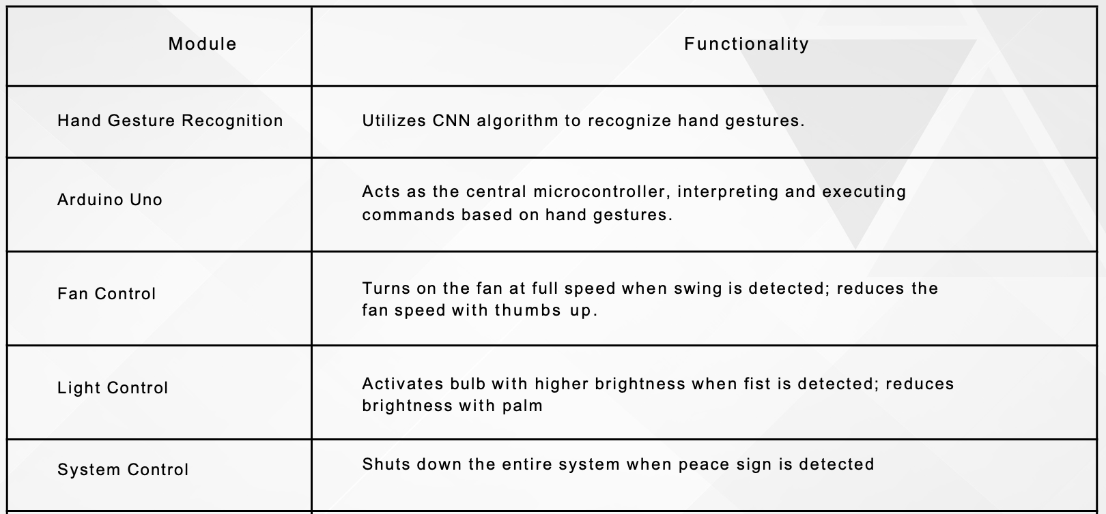
Tabular Column

Slide 16
Research paper Status
Done with Research paper

Slide 17
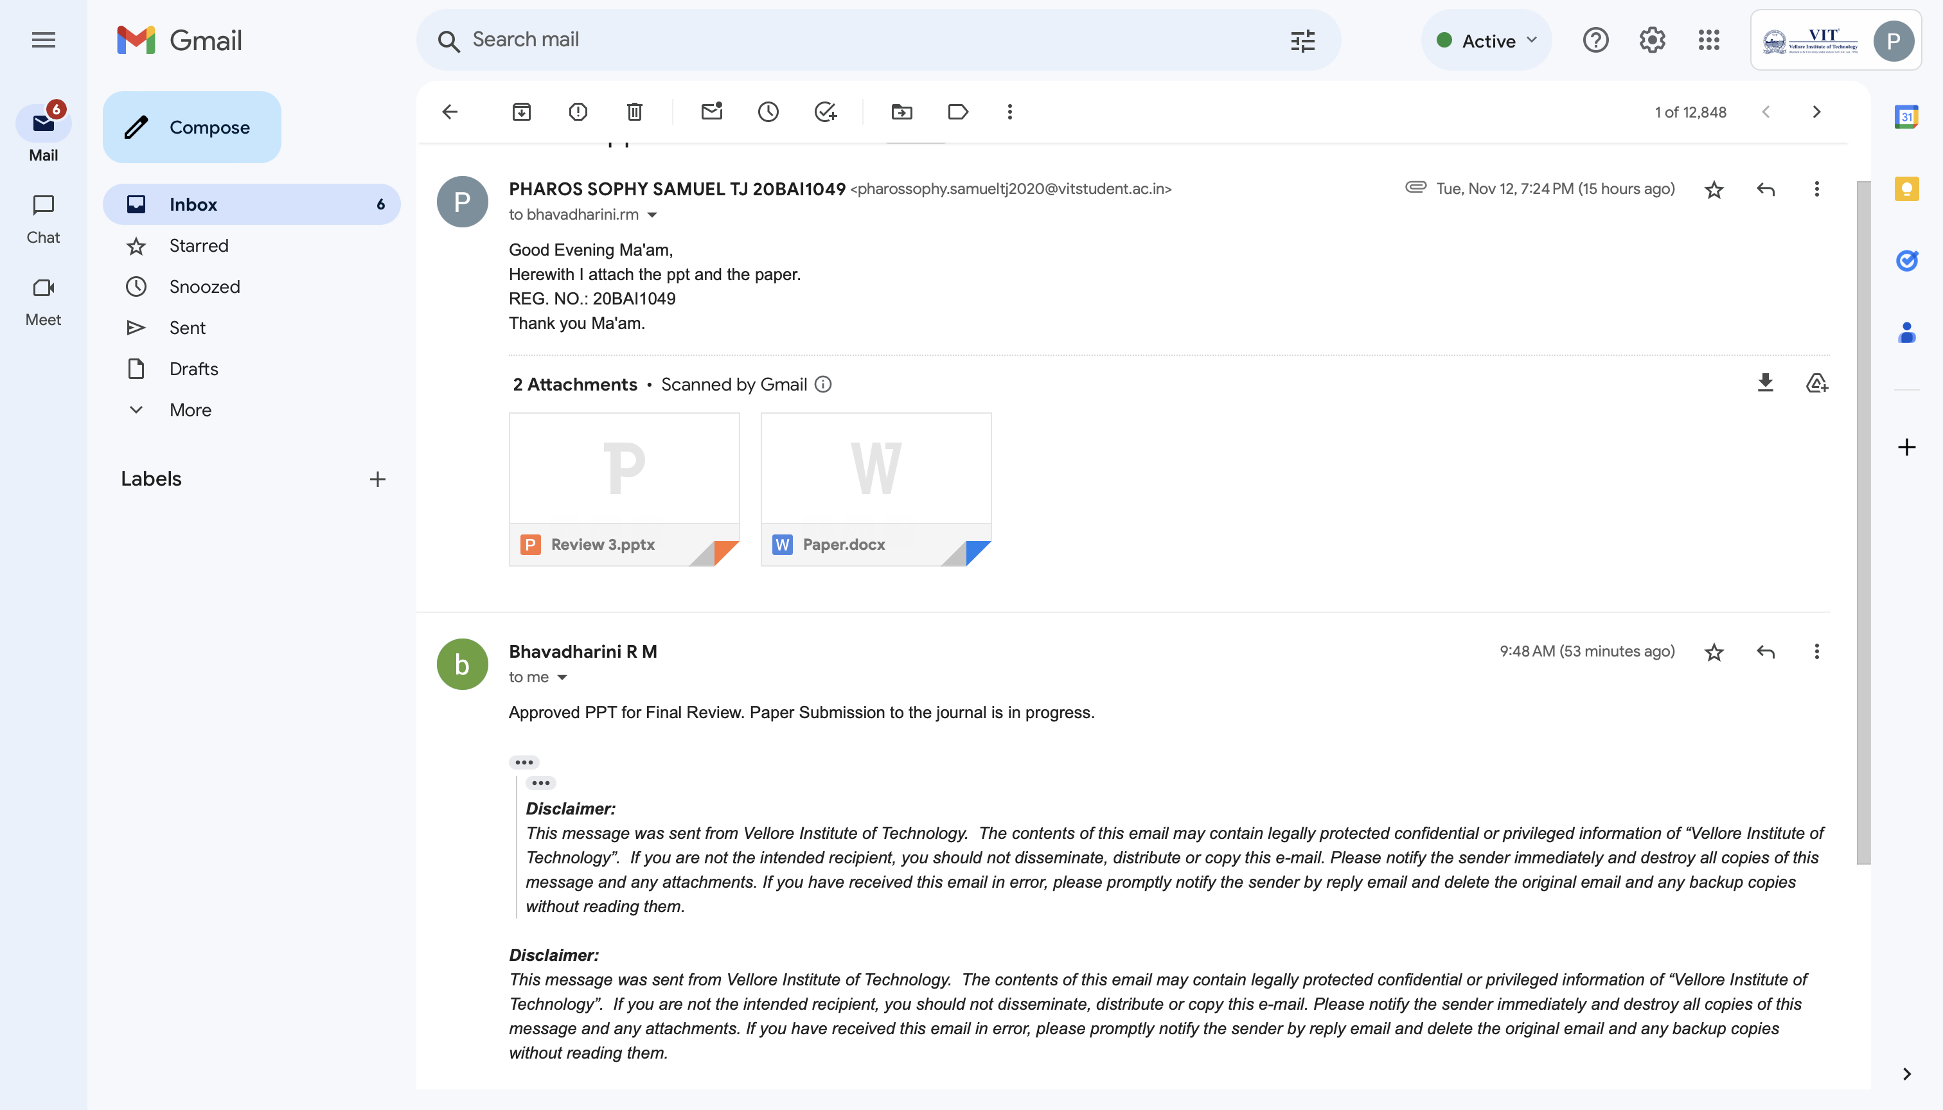
Guide Approval Mail

Slide 18
References
[1] https://www.researchgate.net/publication/372339326_Hand_Gesture_and_Voice_Assistants
[2]https://www.researchgate.net/publication/354046870_Vision_based_Hand_gesture_pattern_recognition_enabled_home_automation_system_using_Internet_of_Things
[3] https://www.sciencedirect.com/science/article/pii/S2772671123002619
[4] https://www.researchgate.net/publication/372984441_IOT_BASED_HOME_APPLICATIONS_CONTROLING_USING_VISION_AND_GESTURE_THROUGH_RASPBERRY_PI
[5] https://www.researchgate.net/publication/359801928_Gestures_Controlled_Home_Automation_using_Deep_Learning_A_Review
[6] https://www.researchgate.net/publication/373923804_HAND_GESTURE_RECOGNITION_USING_RECURRENT_NEURAL_NETWORKS_AND_SYNTHETIC_DATA_GENERATION
[7] https://www.researchgate.net/publication/373066982_Real-Time_Monocular_Skeleton-Based_Hand_Gesture_Recognition_Using_3D-Jointsformer

Slide 19
[8]https://www.researchgate.net/publication/371230969_Computer_Vision_based_Media_Control_using_Hand_Gestures
[9]https://www.researchgate.net/publication/353624643_Convolutional_neural_networks_framework_for_human_hand_gesture_recognition
[10] https://www.researchgate.net/publication/348308219_Improving_Real-Time_Hand_Gesture_Recognition_with_Semantic_Segmentation
[11]https://www.researchgate.net/publication/352167439_Artificial_Intelligence_Based_Smart_Home_Automation_System_Using_Internet_of_Things
[12]https://www.researchgate.net/publication/374846019_Utilizing_ML_for_Hand_Gesture_Recognition
[13]https://www.researchgate.net/publication/369488379_Gesture_Vocabularies_for_Hand_Gestures_for_Controlling_Air_Conditioners_in_Home_and_Vehicle_Environments
[14] https://www.researchgate.net/publication/374388028_HOME_AUTOMATION_SYSTEM
[15] https://www.researchgate.net/publication/372339326_Hand_Gesture_and_Voice_Assistants
[16] https://www.ijraset.com/best-journal/finger-gesture-recognition-based-home-automation-using-iot

Slide 20


Thank You

